Slide 1
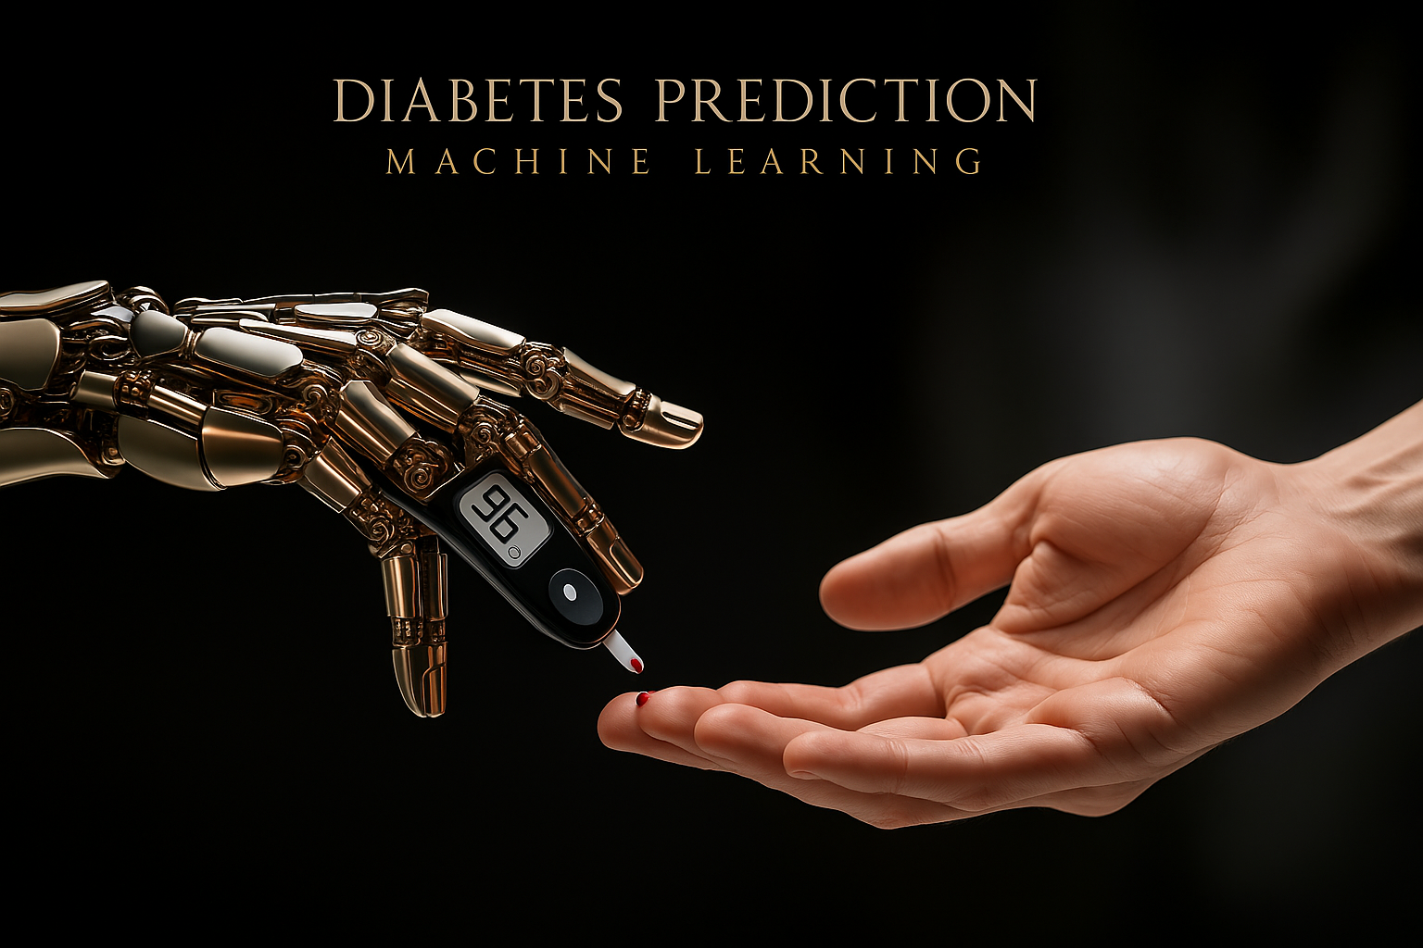

Slide 2
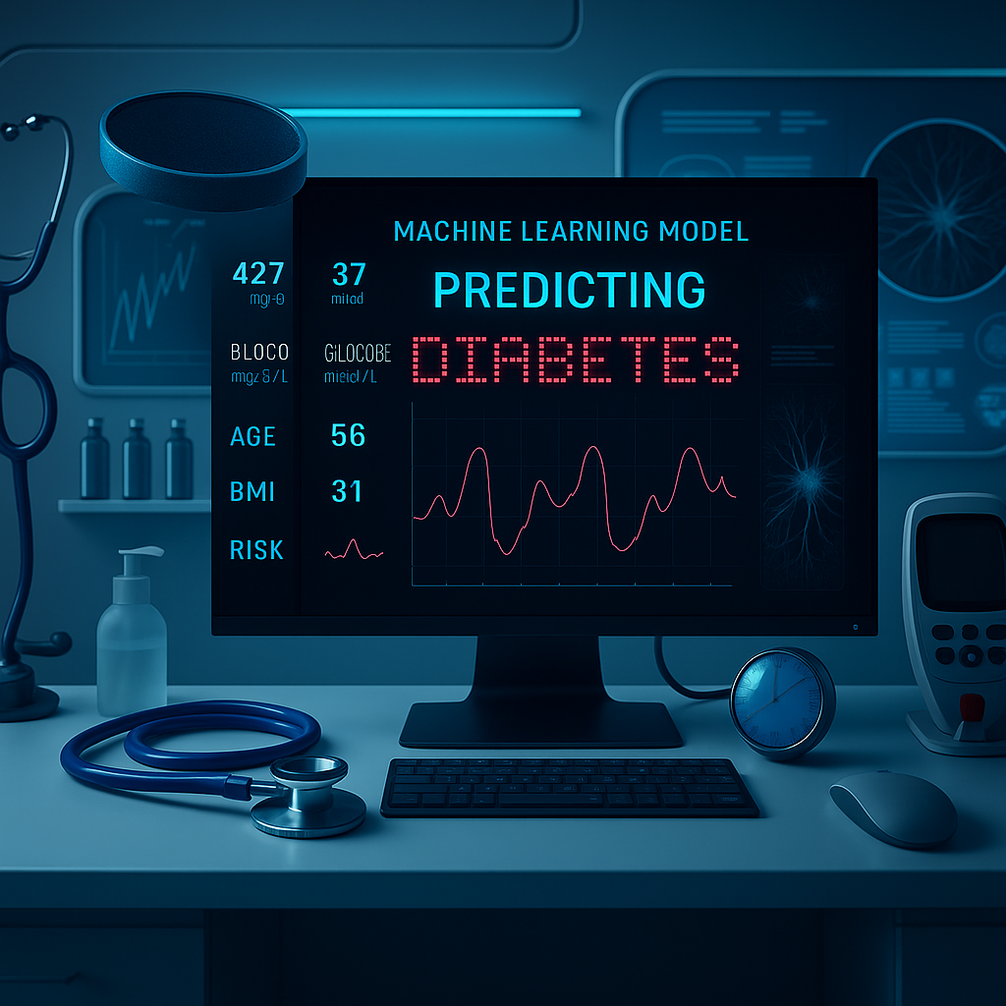
GlucoAI: Smart Diabetes Risk Predictor

Slide 3
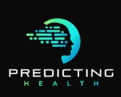
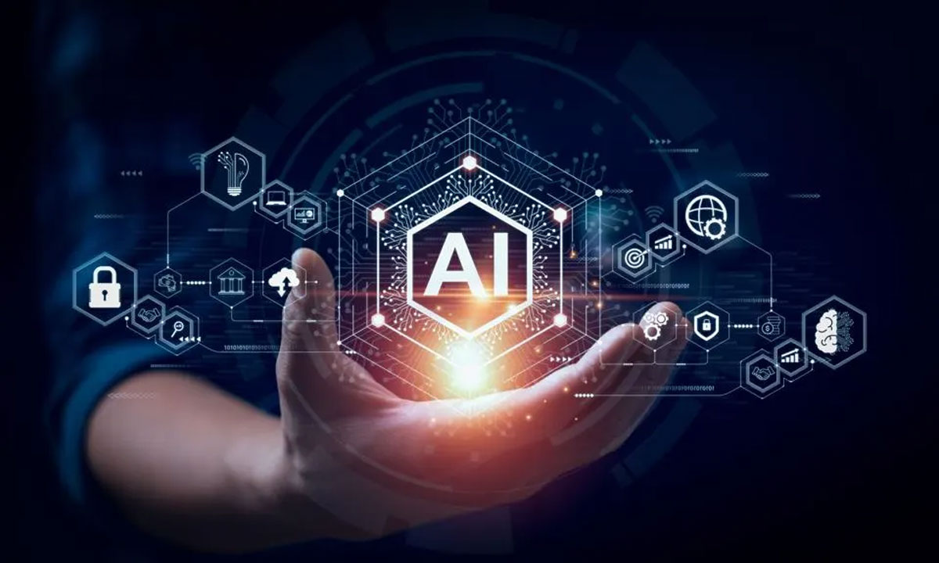
Early Diagnosis, Smarter Decisions with AI
Team Members:
Abhishek G M , 4NI22IS005
Akash R A , 4NI22IS014
Sriharsha M , 4NI22IS252
Harshith C , 4NI22IS253

Slide 4

Introduction :
Diabetes is a chronic illness affecting
millions worldwide.
Early and accurate diagnosis is crucial.
Traditional methods often lead to over-
prescription or under-diagnosis.
Goal: Use AI to accurately predict diabetes
and minimize unnecessary prescriptions.

Slide 5
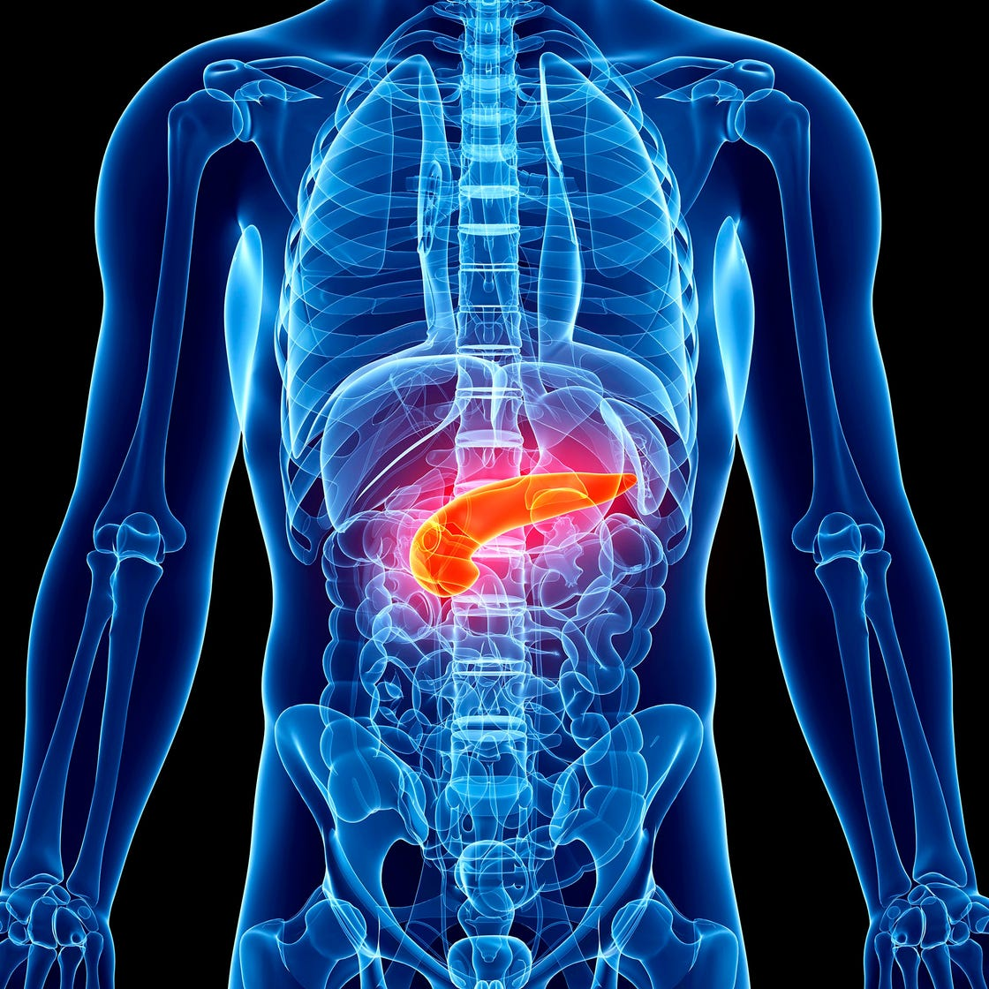
Problem Statement :
Manual diagnosis often lacks consistency.
Existing AI models may overfit or produce false positives.
Patients sometimes get unneeded medical prescriptions.
How can we make a more reliable, intelligent prediction
system?

Slide 6
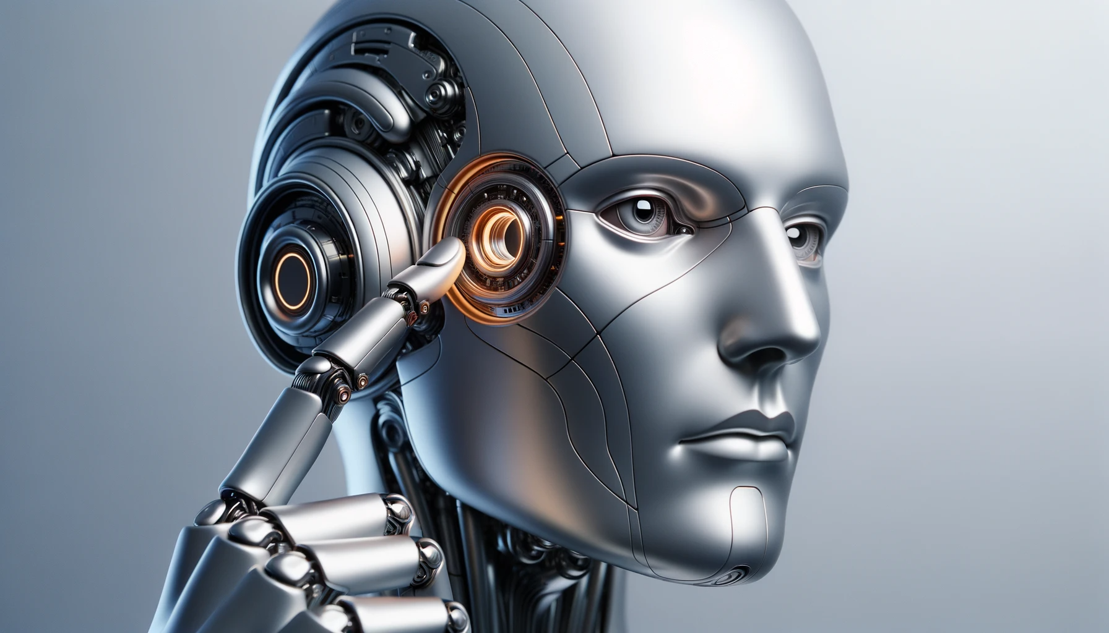
Innovative Idea
Dual-stage Model Training:
Primary Model: Predicts
potential diabetes cases.
Secondary Validator Model:
Filters out false positives to avoid
unnecessary treatment.
Inspired by human-AI collaboration:
a second opinion AI.

Slide 7
Objectives :
Train ML model with medical datasets (e.g., PIMA).
Add a second-layer ML model as a verification stage.
Improve accuracy and reduce overdiagnosis.
Provide smart, data-backed recommendations.

Slide 8
Tools & Technologies:
Python
Scikit-learn, XGBoost, Random Forest
Pandas, NumPy, Matplotlib
Django (for web interface)
VS code
Power BI (for insights and visuals)

Slide 9
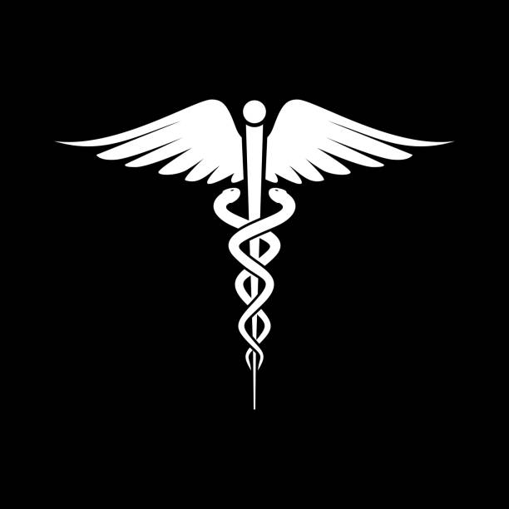
Dataset Overview:
Dataset Used: PIMA Indians Diabetes Dataset
Features:
Glucose Level
Blood Pressure
BMI
Age
Insulin Level
Pregnancies
Diabetes Pedigree Function

Slide 10
How It Work:
Model Training
Trained on 80% of the data
Validated on 20% test data
Used cross-validation
Applied Grid Search for hyperparameter tuning
Used F1-score and ROC-AUC for evaluation

Slide 11
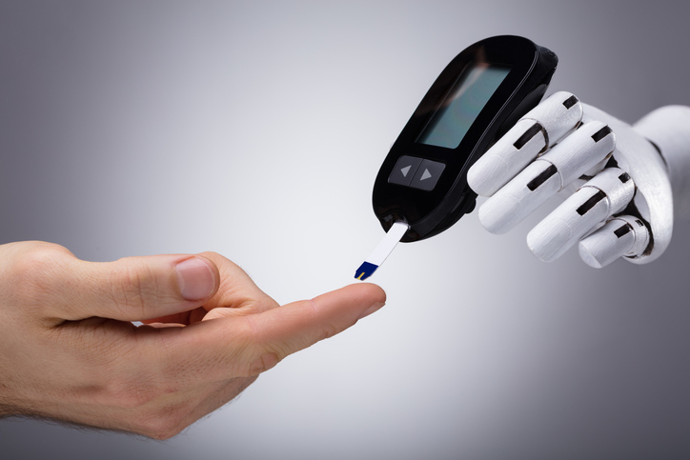
Why Dual-Training is Game-Changer:
Mimics human second opinion logic
Reduces prescription overload
Builds trust in AI systems
Promotes safer diagnostics

Slide 12
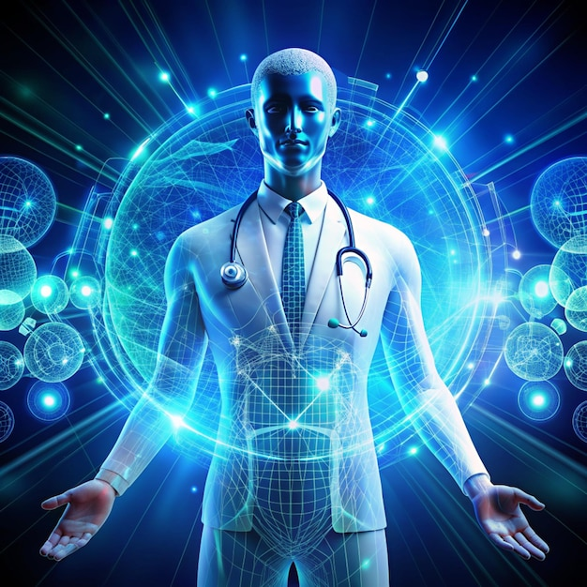
Future Enhancements:
Real-time wearable integration
Support for multi-disease detection
Continuous learning from patient feedback
Doctor-AI collaboration dashboard

Slide 13
Conclusion:
“When artificial intelligence collaborates with human intelligence, we don’t just predict diseases — we prevent despair.”
“True healthcare isn't just about treating illness — it's about predicting and preventing it, intelligently.”
“We trained the machine twice, so patients don’t have to think twice.”
“The future of diagnosis isn't in the hospital — it's in the harmony of data, intelligence, and care.”

Slide 14

THANKYOU
“”Your health, empowered by intelligence.”
Any Questions?

